Slide 1
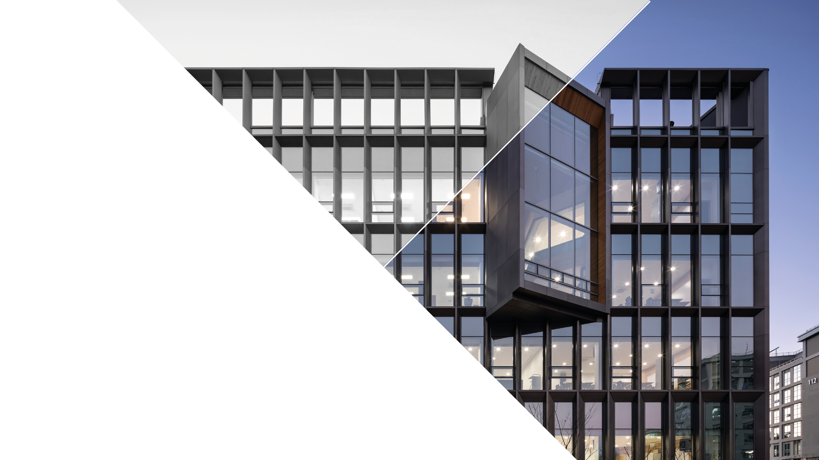

Generalized_ICP
Janu 03, 2023
CONTACT
Electrical Engineering
1st Engineering Building Room 201
Tel. +82 52 217 3542 Web. http://eche.unist.ac.krAddress

Slide 2
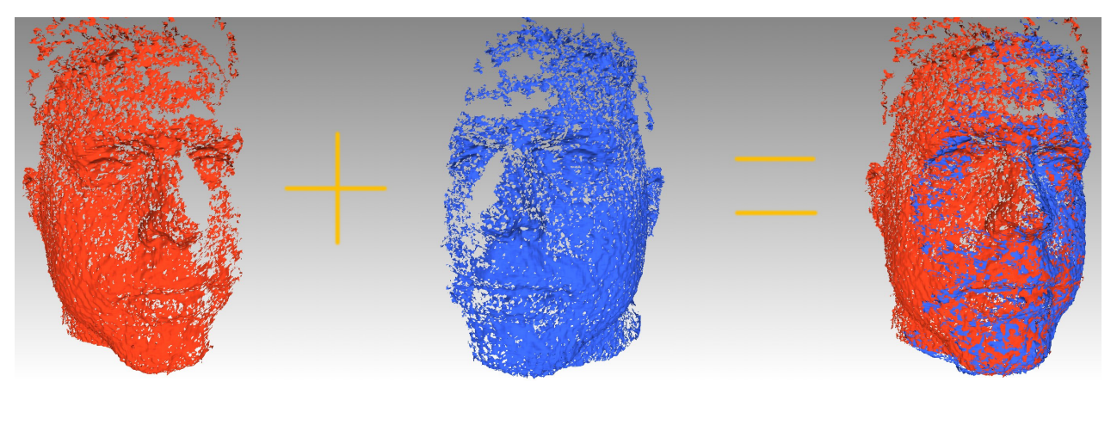
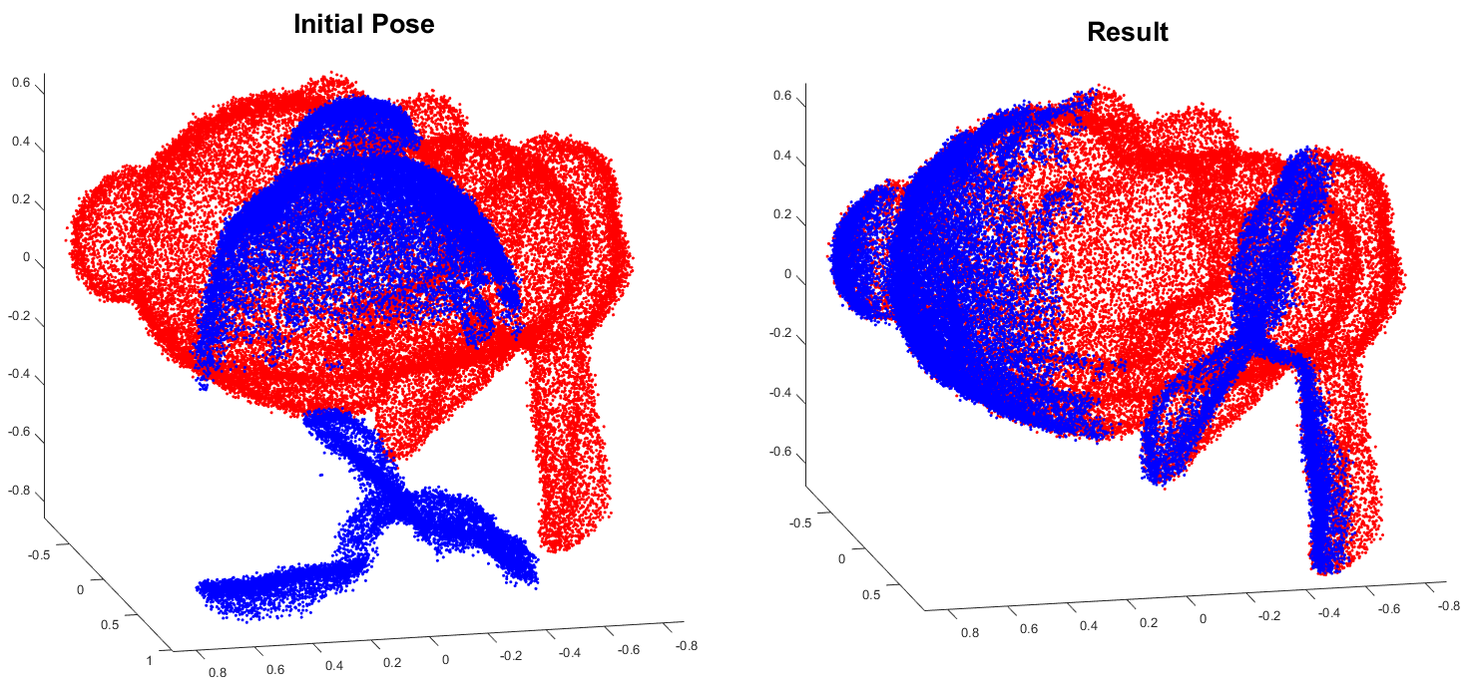

ICPs

Slide 3
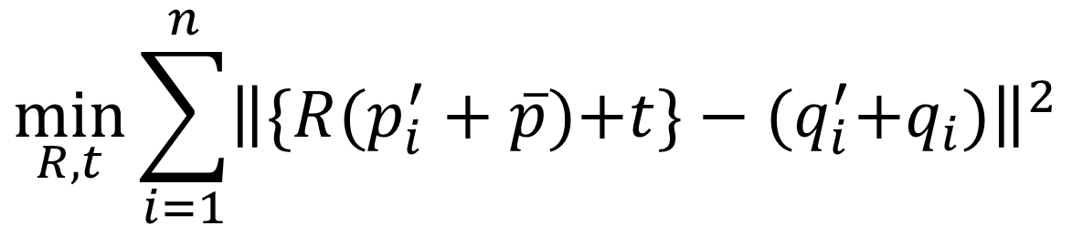
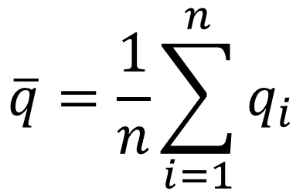
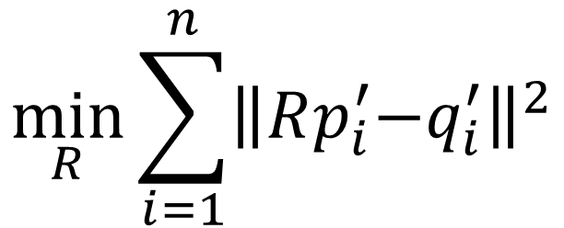
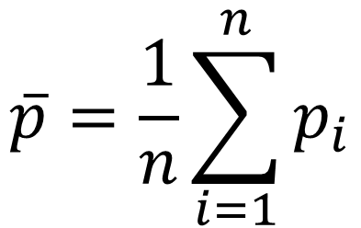
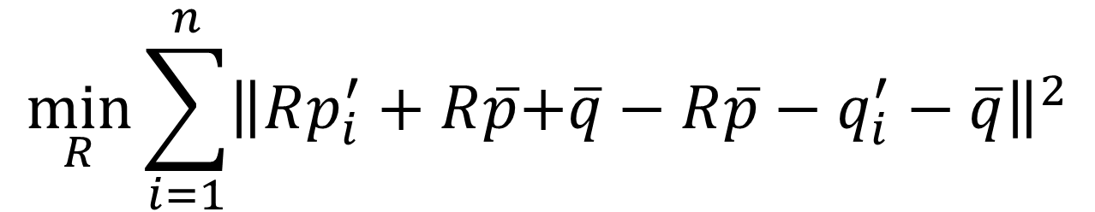
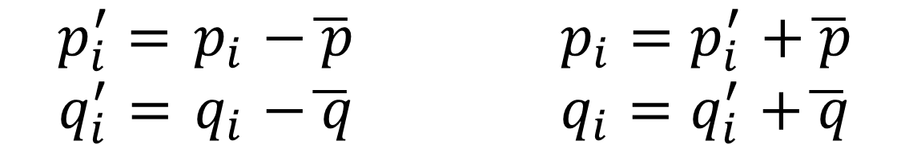
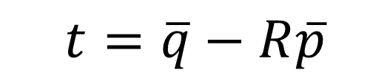
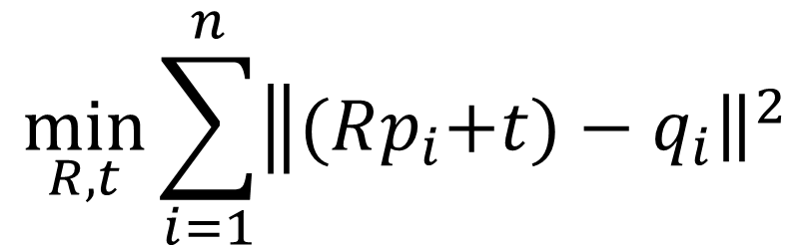
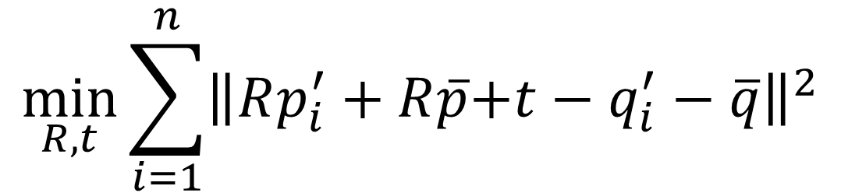
Standard ICP
Original problem
$$\min_{R,t}{\sum_{i=1}^{n}{{\left\|(Rp_{i}\right.\left.+t)−q_{i}\right\|}^{2}}}$$
$$\min_{R,t}{\sum_{i=1}^{n}{{\left\|\{R\right.(p_{i}^{′}+\overline{p})\left.+t\}−(q_{i}^{′}{+q}_{i})\right\|}^{2}}}$$
Centroid
$$\min_{R,t}{\sum_{i=1}^{n}{{\left\|R\right.p_{i}^{′}+R\overline{p}\left.+t−q_{i}^{′}−\overline{q}\right\|}^{2}}}$$
$$\overline{p}=\frac{1}{n}\sum_{i=1}^{n}{p_{i}}$$
Source :
Let’s assume
$$t=\overline{q}−R\overline{p}$$
$$\min_{R}{\sum_{i=1}^{n}{{\left\|R\right.p_{i}^{′}+R\overline{p}\left.+\overline{q}−R\overline{p}−q_{i}^{′}−\overline{q}\right\|}^{2}}}$$
$$\overline{q}=\frac{1}{n}\sum_{i=1}^{n}{q_{i}}$$
Target :
$$\min_{R}{\sum_{i=1}^{n}{{\left\|R\right.p_{i}^{′}\left.−q_{i}^{′}\right\|}^{2}}}$$
Decoupling the translation
$$p_{i}^{′}={ p}_{i }−\overline{ p} { p}_{i }{=p}_{i}^{′}+\overline{ p}$$
$$q_{i}^{′}={ q}_{i }−\overline{ q} { q}_{i }{=q}_{i}^{′}+\overline{ q}$$

Slide 4
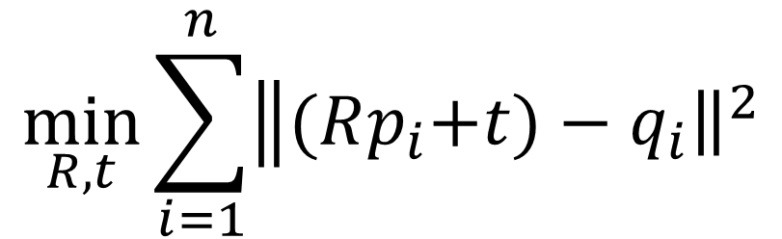
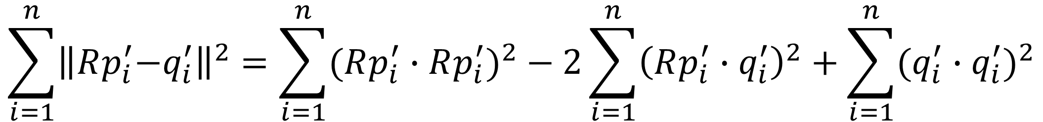
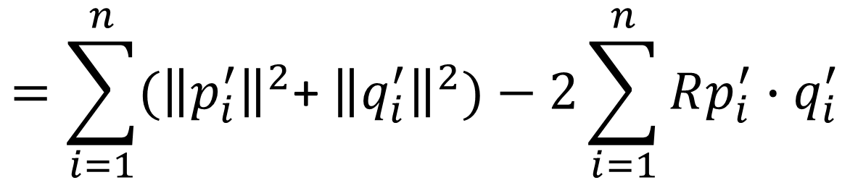
Standard ICP
Original problem
$$\min_{R,t}{\sum_{i=1}^{n}{{\left\|(Rp_{i}\right.\left.+t)−q_{i}\right\|}^{2}}}$$
Dual problem
$$\sum_{i=1}^{n}{{\left\|R\right.p_{i}^{′}\left.−q_{i}^{′}\right\|}^{2}}=\sum_{i=1}^{n}{{(Rp_{i}^{′}∙Rp_{i}^{′})}^{2}}−2\sum_{i=1}^{n}{{\left(Rp_{i}^{′}∙q_{i}^{′}\right)}^{2}}+\sum_{i=1}^{n}{{(q_{i}^{′}∙q_{i}^{′})}^{2}}$$
$$=\sum_{i=1}^{n}{({\left\|p_{i}^{′}\right\|}^{2}\text{+ }{\left\|q_{i}^{′}\right\|}^{2})}−2\sum_{i=1}^{n}{Rp_{i}^{′}∙q_{i}^{′}}$$
Independ
on Rotation
Depend
on Rotation

Slide 5
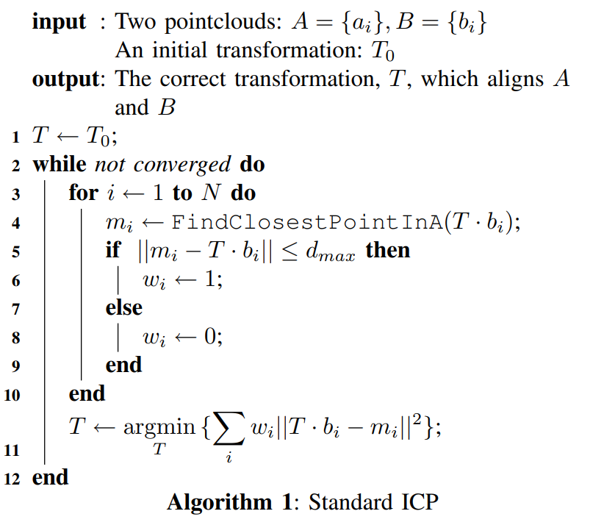
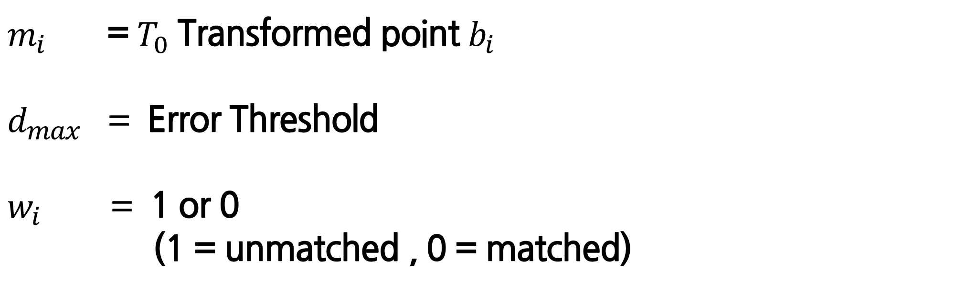
Standard ICP
ICP Code
1) Compute correspondences between the two scans
2) Compute a transformation which minimizes distance between corresponding points
$m_{i}$ = $T_{0}$ Transformed point $b_{i}$
$d_{max}$ = Error Threshold
$w_{i}$ = 1 or 0
(1 = unmatched , 0 = matched)

Slide 6
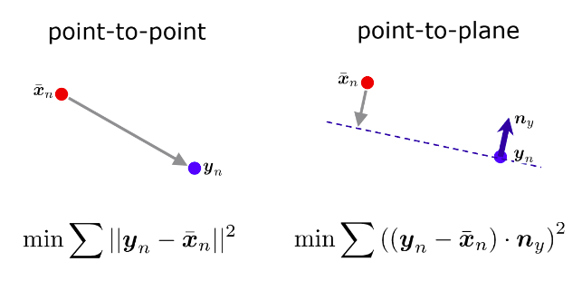
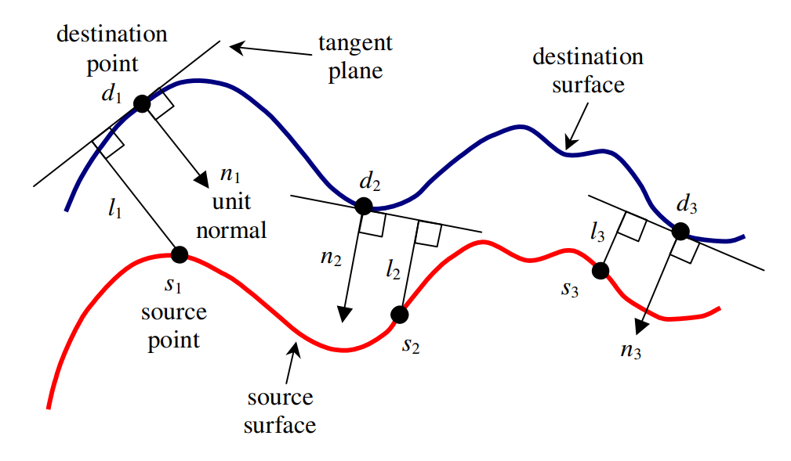
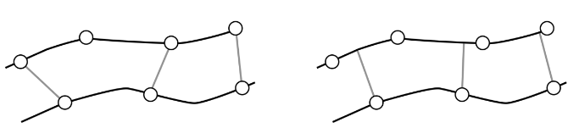
Point-to-plane ICP

Slide 7
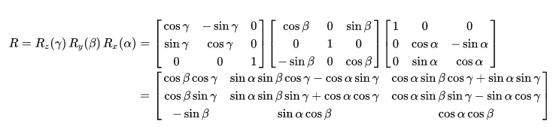
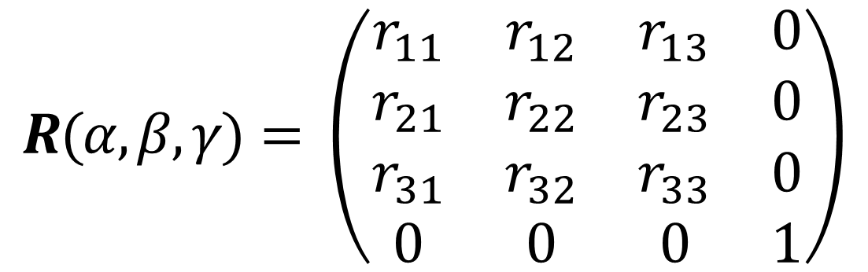
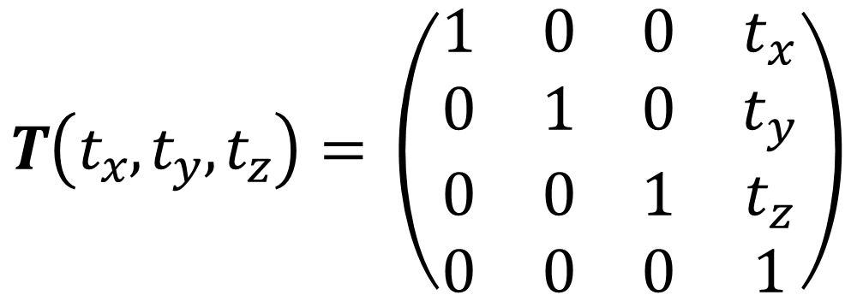
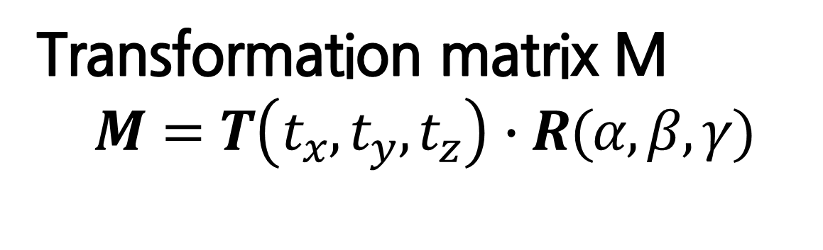

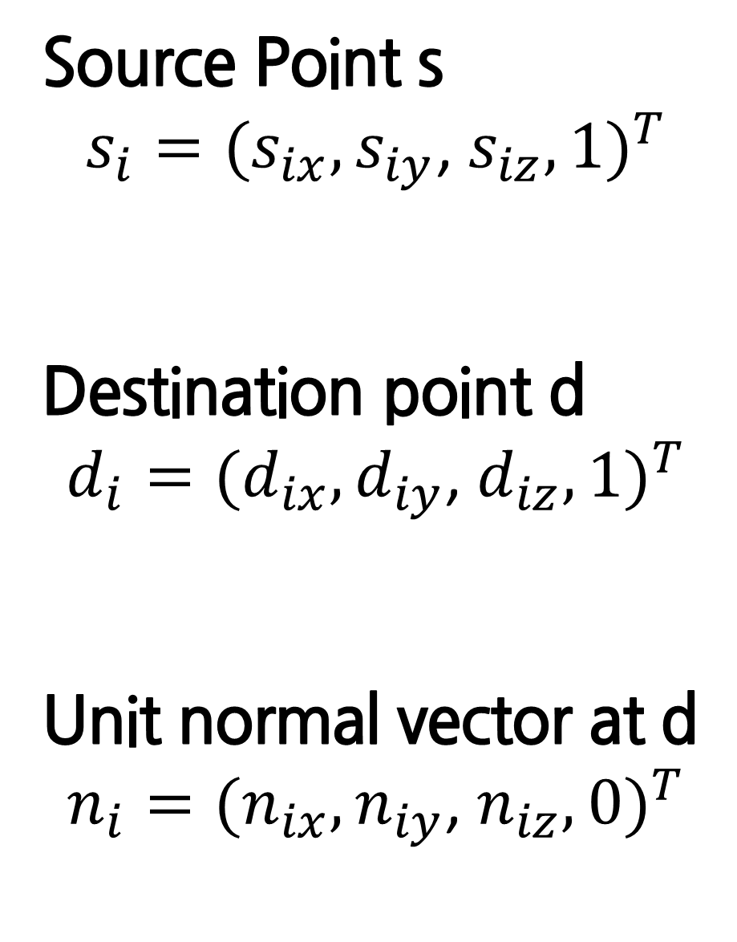
Original problem
Point-to-plane ICP
$$M_{opt}=\underset{M}{arg min}{\sum_{i}{{((M∙s_{i}−d_{i})∙n_{i})}^{2}}}$$
Transformation matrix M
$$M=T\left(t_{x}, t_{y}, t_{z}\right)∙R(α, β, γ)$$
Source Point s
$$s_{i}={(s}_{ix},s_{iy}\text{,}{{ s}_{iz}, 1)}^{T}$$
Destination point d
$$d_{i}={(d}_{ix},d_{iy}\text{,}{ d_{iz}, 1)}^{T}$$
Unit normal vector at d
$$n_{i}={(n}_{ix},n_{iy}\text{,}{ n_{iz}, 0)}^{T}$$
$$T\left(t_{x}, t_{y}, t_{z}\right)= \left(\begin{matrix}1 & 0 & 0 & t_{x} \\ 0 & 1 & 0 & t_{y} \\ 0 & 0 & 1 & t_{z} \\ 0 & 0 & 0 & 1\end{matrix}\right)$$
$$R(α, β, γ)= \left(\begin{matrix}r_{11} & r_{12} & r_{13} & 0 \\ r_{21} & r_{22} & r_{23} & 0 \\ r_{31} & r_{32} & r_{33} & 0 \\ 0 & 0 & 0 & 1\end{matrix}\right)$$
<Extrinsic Rotation>

Slide 8
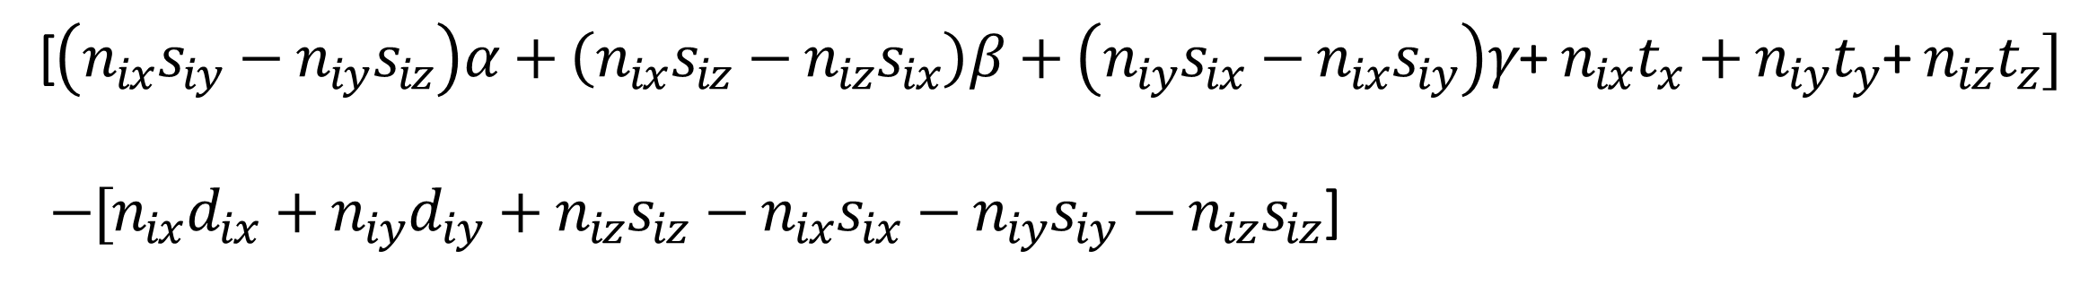

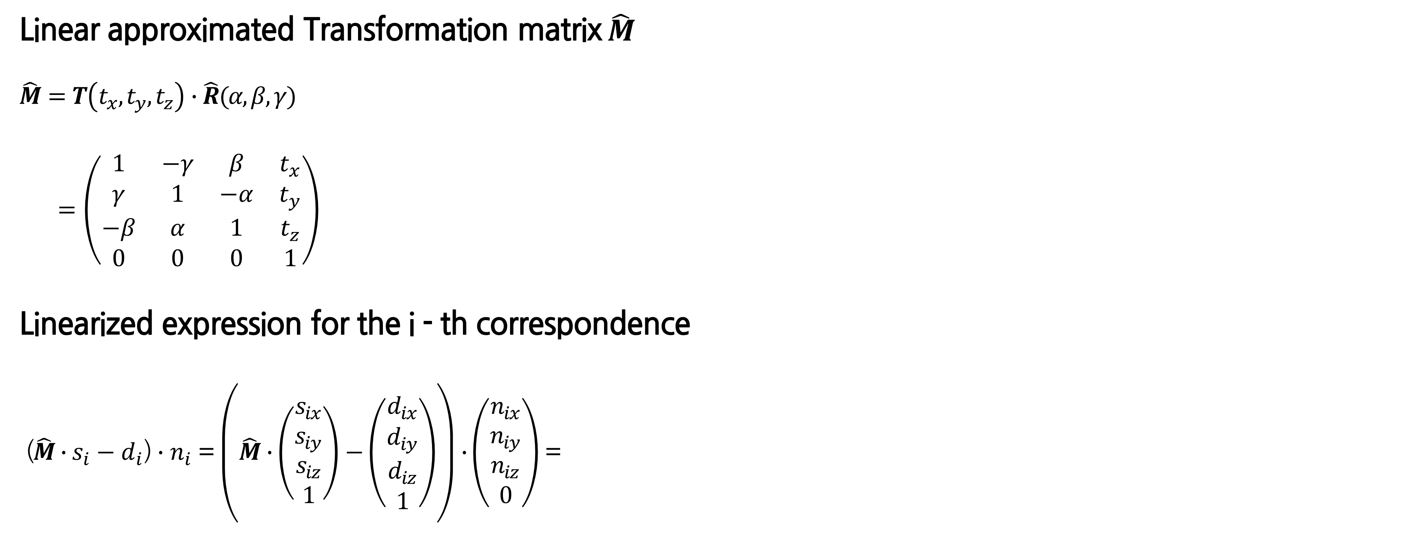
Original problem
Point-to-plane ICP
$$M_{opt}=\underset{M}{arg min}{\sum_{i}{{((M∙s_{i}−d_{i})∙n_{i})}^{2}}}$$
Linear approximated Transformation matrix$\hat{M}$
$$\hat{M}=T\left(t_{x}, t_{y}, t_{z}\right)∙\hat{R}(α, β, γ)$$
$=\left(\begin{matrix}1 & −γ & β & t_{x} \\ γ & 1 & −α & t_{y} \\ −β & α & 1 & t_{z} \\ 0 & 0 & 0 & 1\end{matrix}\right)$
Linearized expression for the i - th correspondence
($\hat{M}∙s_{i}−d_{i}$) $∙n_{i}$ = $\left(\hat{M}∙\left(\begin{matrix}s_{ix} \\ s_{iy} \\ s_{iz} \\ 1\end{matrix}\right)−\left(\begin{matrix}d_{ix} \\ d_{iy} \\ d_{iz} \\ 1\end{matrix}\right)\right)∙$ $\left(\begin{matrix}n_{ix} \\ n_{iy} \\ n_{iz} \\ 0\end{matrix}\right)$ =
[$\left(n_{ix}s_{iy}−n_{iy}s_{iz}\right)α+\left(n_{ix}s_{iz}−n_{iz}s_{ix}\right)β+\left(n_{iy}s_{ix}−n_{ix}s_{iy}\right)γ$+ $n_{ix}t_{x}+n_{iy}t_{y}$+ $n_{iz}t_{z}]$
$−[n_{ix}d_{ix}+n_{iy}d_{iy}+n_{iz}s_{iz}−n_{ix}s_{ix}−n_{iy}s_{iy}−n_{iz}s_{iz}$]

Slide 9
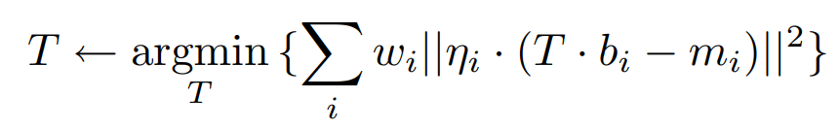
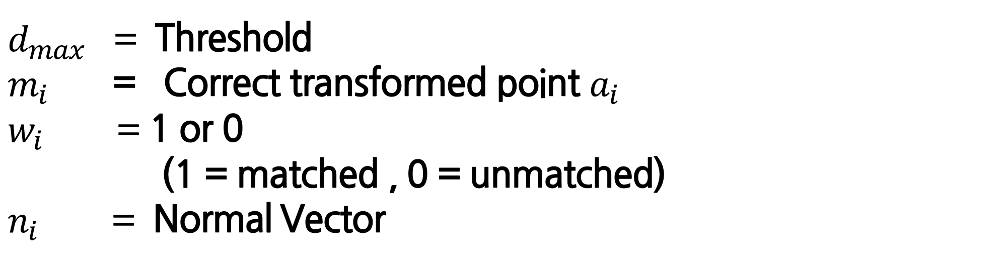
Point-to-plane ICP
Point to Plane ICP Code
1) Compute correspondences between the two scans
2) Compute a transformation which minimizes distance between corresponding points
$d_{max}$ = Threshold
$m_{i}$ = Correct transformed point $a_{i}$
$w_{i}$ = 1 or 0
(1 = matched , 0 = unmatched)
$n_{i}$ = Normal Vector

Slide 10
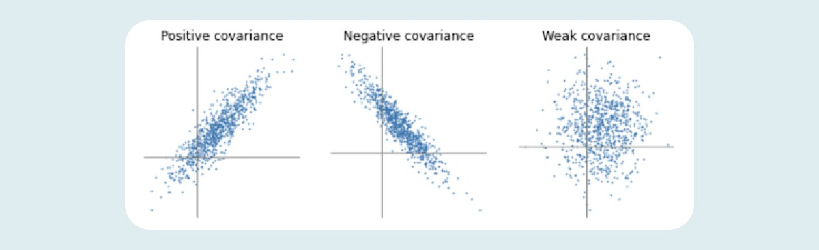
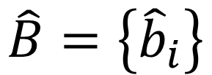
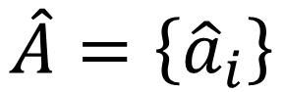
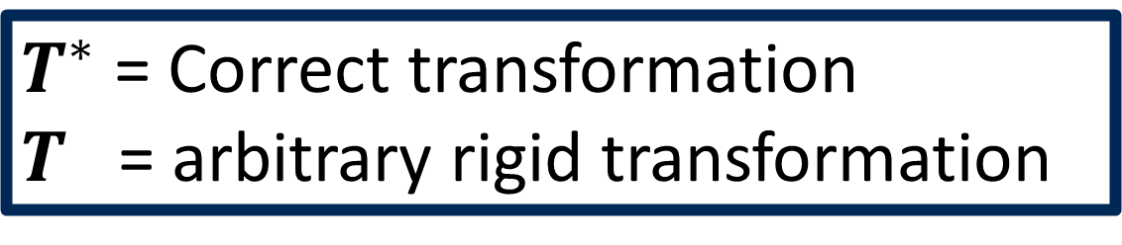
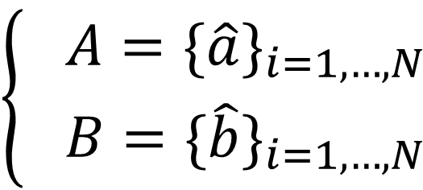
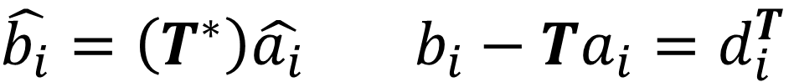
Generalized-ICP
4
$$\left\{\begin{aligned} A={\{\hat{a}\}}_{i=1,…,N} \\ B={\{\hat{b}\}}_{i=1,…,N}\end{aligned}\right.$$
Point Cloud
$$\hat{A}=\left\{{\hat{a}}_{i}\right\}$$
$$\hat{B}=\left\{{\hat{b}}_{i}\right\}$$
$a_{i} {\sim N(\hat{a}}_{i},C_{i}^{A})$ $b_{i} {\sim N(\hat{b}}_{i},C_{i}^{B})$
$\hat{b_{i}}=\left(T^{∗}\right)\hat{a_{i}}$ $b_{i}−Ta_{i}=d_{i}^{T}$
$T^{∗}$ = Correct transformation
$T$ = arbitrary rigid transformation
Point Matching
distance
$$d_{i}^{T^{∗}} \sim N(\hat{b_{i}}−\left(T^{∗}\right)\hat{a_{i}},C_{i}^{B}+(T^{∗})C_{i}^{A}({T^{∗})}^{T})$$
$=N(0, C_{i}^{B}+(T^{∗})C_{i}^{A}({T^{∗})}^{T})$ -> distance can made gaussian model
Notes:
Covariance를 활용함에 따라 Guassian 확률 분포를 distance에 접목 시킬 수 있다. 즉 해당 matching 시킨 point 들이 dependent한지 경향성을 볼 수 있음.

Slide 11
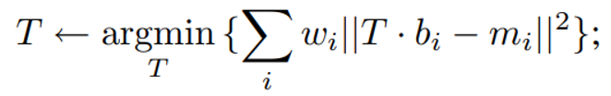
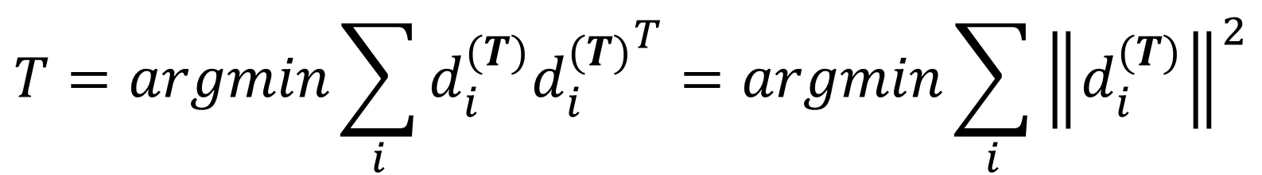

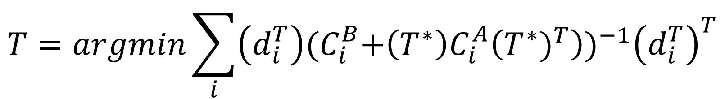
Generalized-ICP
4
$$T=argmin\sum_{i}{\left(d_{i}^{T}\right){{(C}_{i}^{B}+\left(T^{∗}\right)C_{i}^{A}\left({T^{∗})}^{T}\right))}^{−1}{\left(d_{i}^{T}\right)}^{T}}$$
Then $C_{i}^{A}$ = 0, $C_{i}^{B}=I$
$$T=argmin\sum_{i}{d_{i}^{(T)}{d_{i}^{(T)}}^{T}}=argmin\sum_{i}{{\left\|d_{i}^{(T)}\right\|}^{2}}$$
Same as standard ICP algorithm => Minimize distance between point cloud
Notes:
Generalized ICP 가 standard ICP 와 Point to Plane보다 좋다고 증명

Slide 12
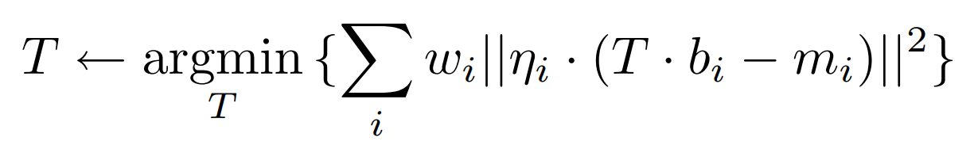
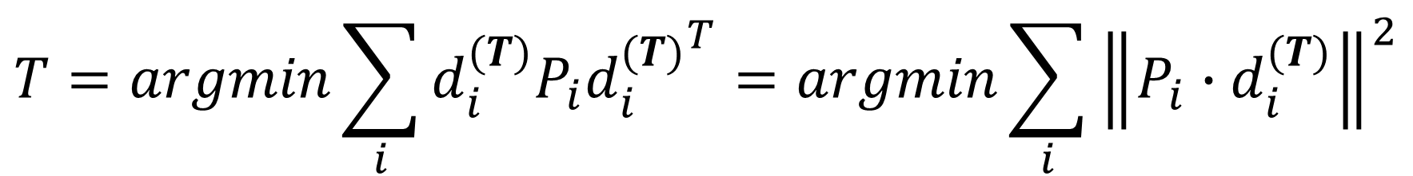
Generalized-ICP
4
$$T=argmin\sum_{i}{\left(d_{i}^{T}\right){{(C}_{i}^{B}+\left(T^{∗}\right)C_{i}^{A}\left({T^{∗})}^{T}\right))}^{−1}{\left(d_{i}^{T}\right)}^{T}}$$
Then $C_{i}^{A}$ = 0, $C_{i}^{B}=P_{i}^{−1}$ $(P_{i}$ is projection matrix of a’s surface normal)
$$T=argmin\sum_{i}{d_{i}^{(T)}P_{i}{d_{i}^{(T)}}^{T}}=argmin\sum_{i}{{\left\|P_{i}∙d_{i}^{(T)}\right\|}^{2}}$$
Same as Point to plane ICP algorithm => Minimize normal vector dot product

Slide 13
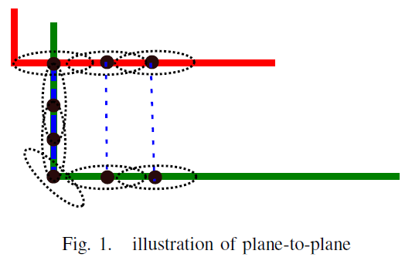
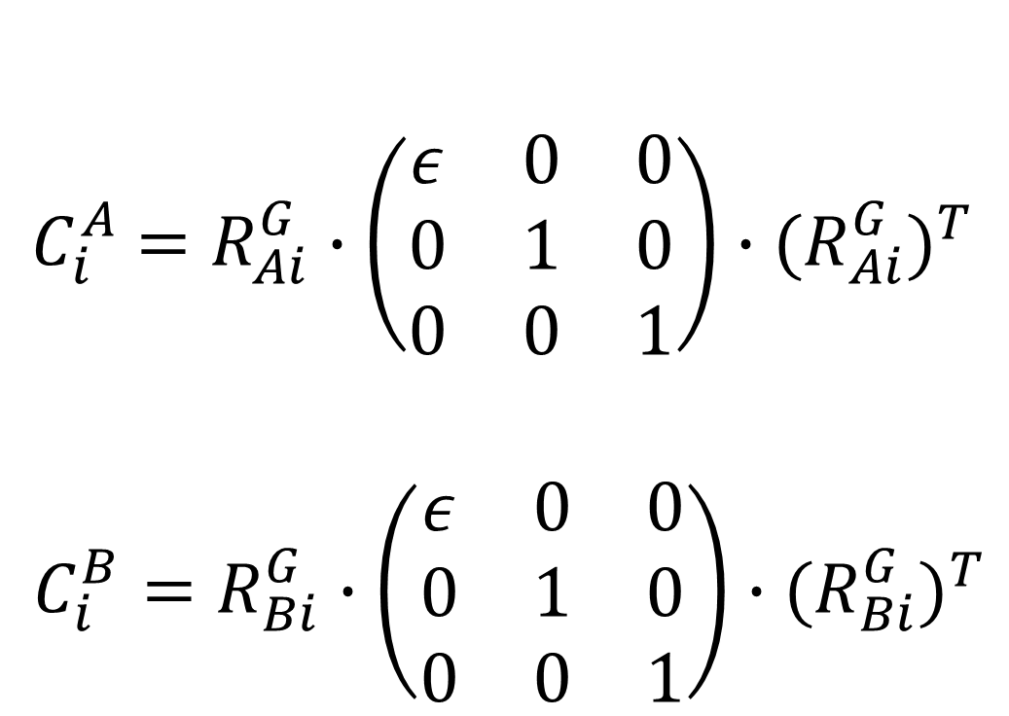
Generalized-ICP
4
<Covariance>
$${ C}_{i}^{A} =R_{Ai}^{G}∙\left(\begin{matrix}ε & 0 & 0 \\ 0 & 1 & 0 \\ 0 & 0 & 1\end{matrix}\right)∙{{(R}_{Ai}^{G})}^{T}$$
$C_{i}^{B}=R_{Bi}^{G}∙\left(\begin{matrix}ε & 0 & 0 \\ 0 & 1 & 0 \\ 0 & 0 & 1\end{matrix}\right)∙{{(R}_{Bi}^{G})}^{T}$
Scan A
Scan B
Point to Plane ICP = matched
Generalized ICP = unmatched / Covariance is isotropic

Slide 14
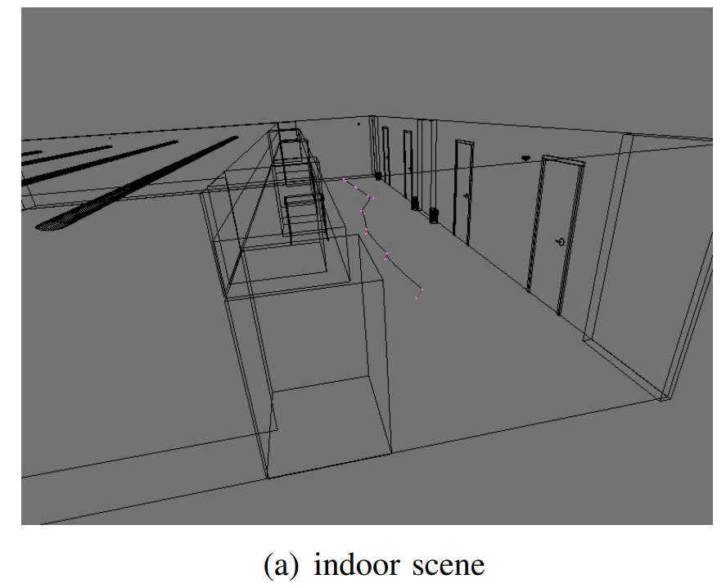
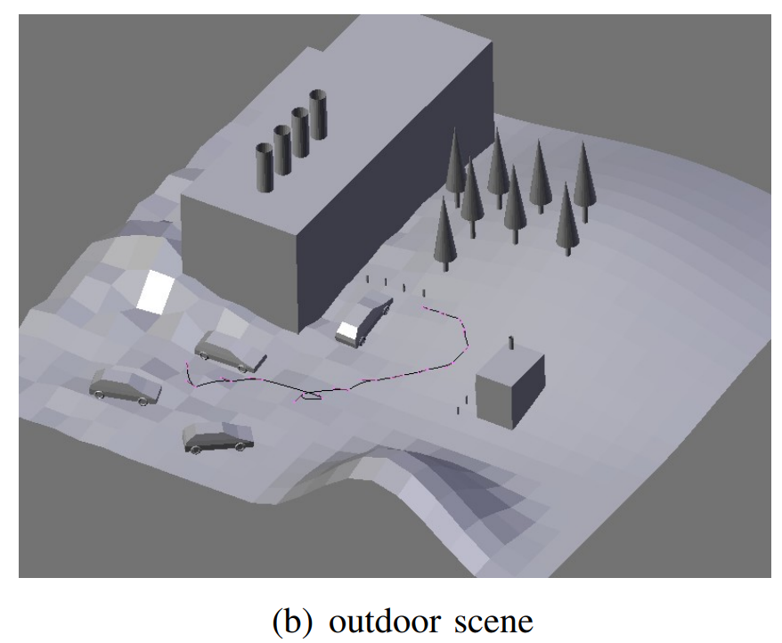
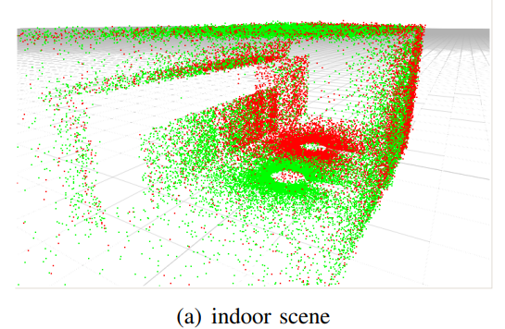
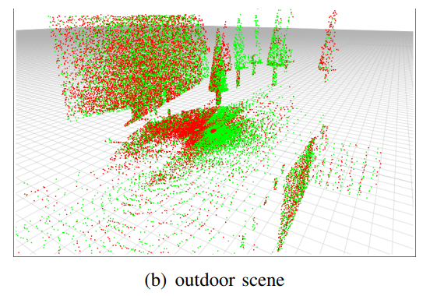
Result
4
Scan A
Scan B

Slide 15
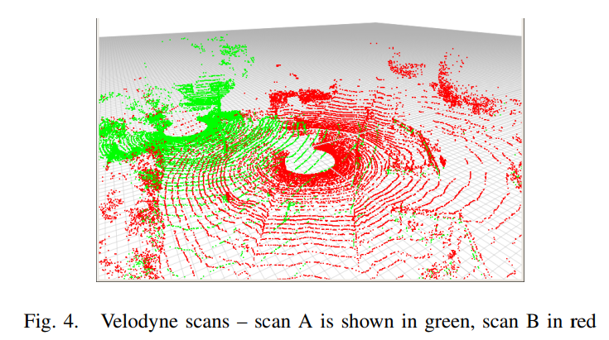
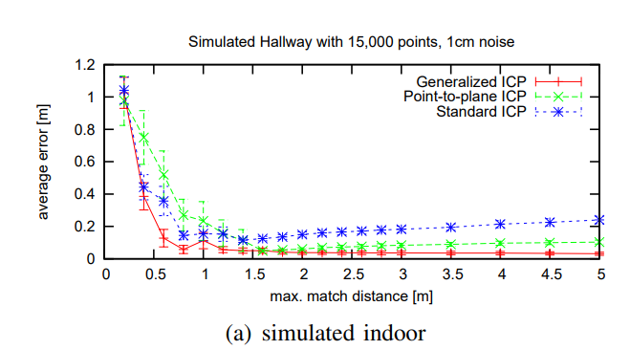
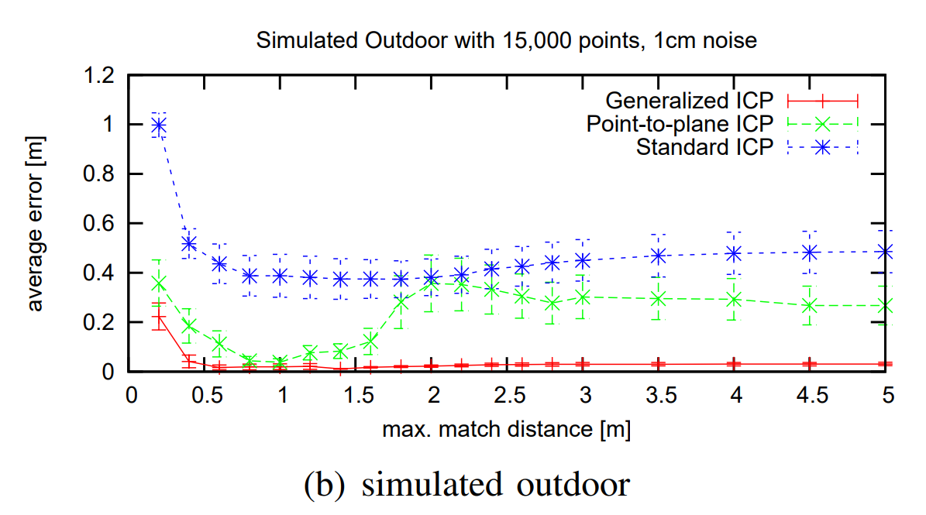
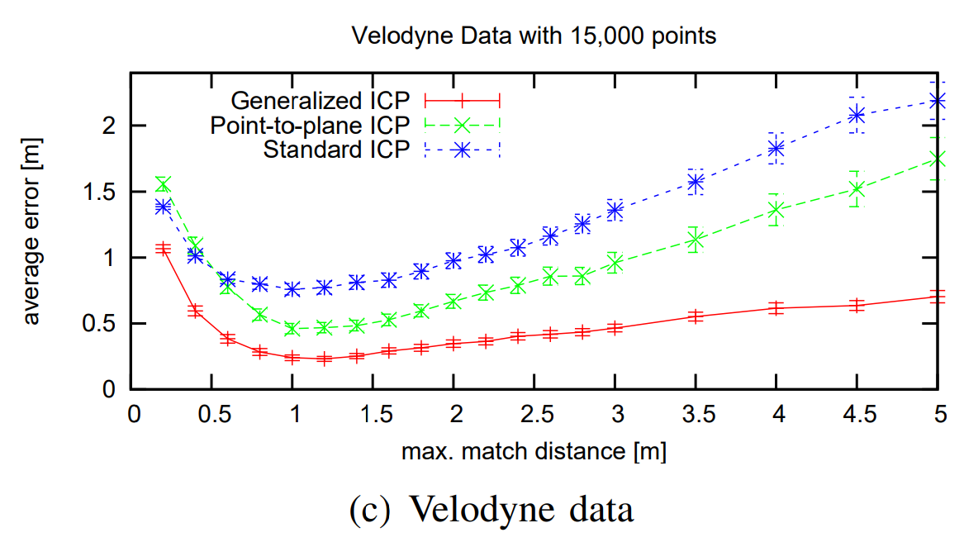
Result
4

Slide 16

Result
4
Average Error
(Generalized ICP < Point-to-plane ICP <Standard ICP)

Slide 17


Result
4
Average Error
(Generalized ICP < Point-to-plane ICP <Standard ICP)
2. ICP’s difference
(Scan Pair #31, #45 )

Slide 18


Result
4
Scan A
Scan B

Slide 19
ICP’s Limitation
대규모 포인트 클라우드 데이터를 처리할 때, 실시간 요구 사항을 충족 불가
2. 스캔할 시 생기는 불필요한 특징점이 생김에도 처리 불가하여, 후속 처리의 시간 증가
-> SLAM
실시간 정합을 위해, 공간인덱싱 등 속도를 고려함
2. 특징점을 통한 계산량 감소

Slide 20
THANK YOU

